Slide 1




Machine Learning Operations
1

Slide 2

Meet our team
Parsa
Mahyar
Salar
2

Slide 3
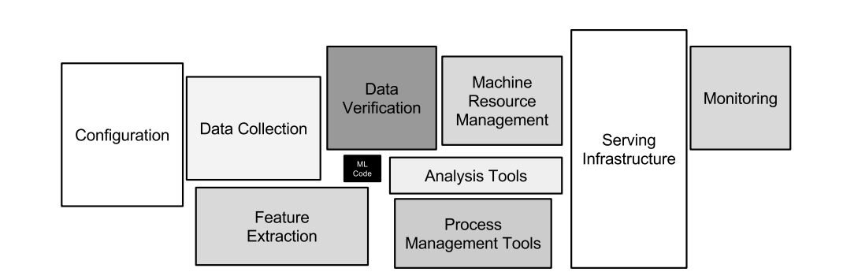
What is MLOps?
MLOps = Machine Learning + DevOps
A way to manage the end-to-end machine learning lifecycle
About 5% to 10% of ml project is model code
3

Slide 4
Why Do We Need MLOps?
4

Slide 5
01
Easier to deploy
02
Easier to maintain
03
Easier to monitor
5

Slide 6
DevOps vs MLOps
Aspect | DevOps | MLOps
Focus | Software applications | Machine learning models
Data | Not a major concern | Central: data collection, labeling, drift
Testing | Unit & integration tests | Model validation, error analysis, fairness tests
Deployment | Code deployment to servers | Model deployment + continuous monitoring
6

Slide 7
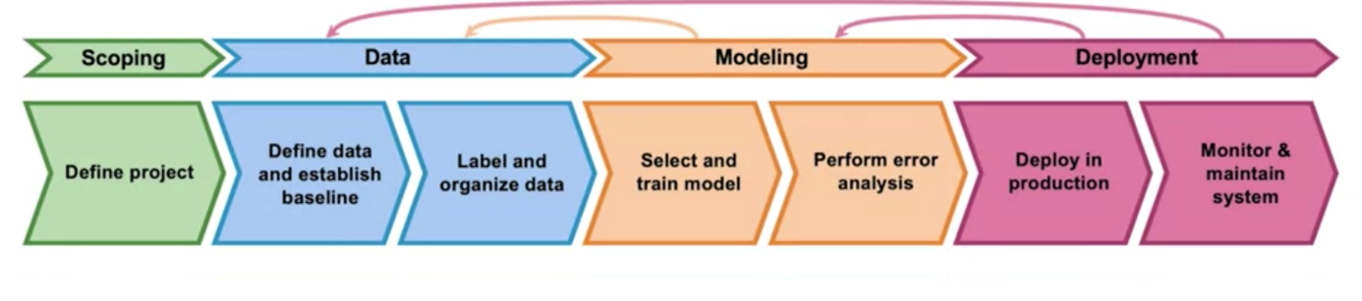
MLOps Workflow
7

Slide 8
Scoping
01
Define the project
What is X?
What is y?
The goal of the project?
8

Slide 9
Data
02
Collect & organize data from reliable sources
Label data correctly
Establish a baseline
Ensure data quality & consistency
9

Slide 10
Modeling
03
Select a model that fits the problem
Train the model using the prepared data
Perform error analysis
10

Slide 11
Deployment
04
Make the model available to real users or systems
track accuracy, speed, and fairness
Update or retrain the model as data changes
Fix issues quickly to keep reliability high
11

Slide 12

Challenges in MLOps
Data drift
Changing environments
Scaling infrastructure
Team collaboration
12

Slide 13
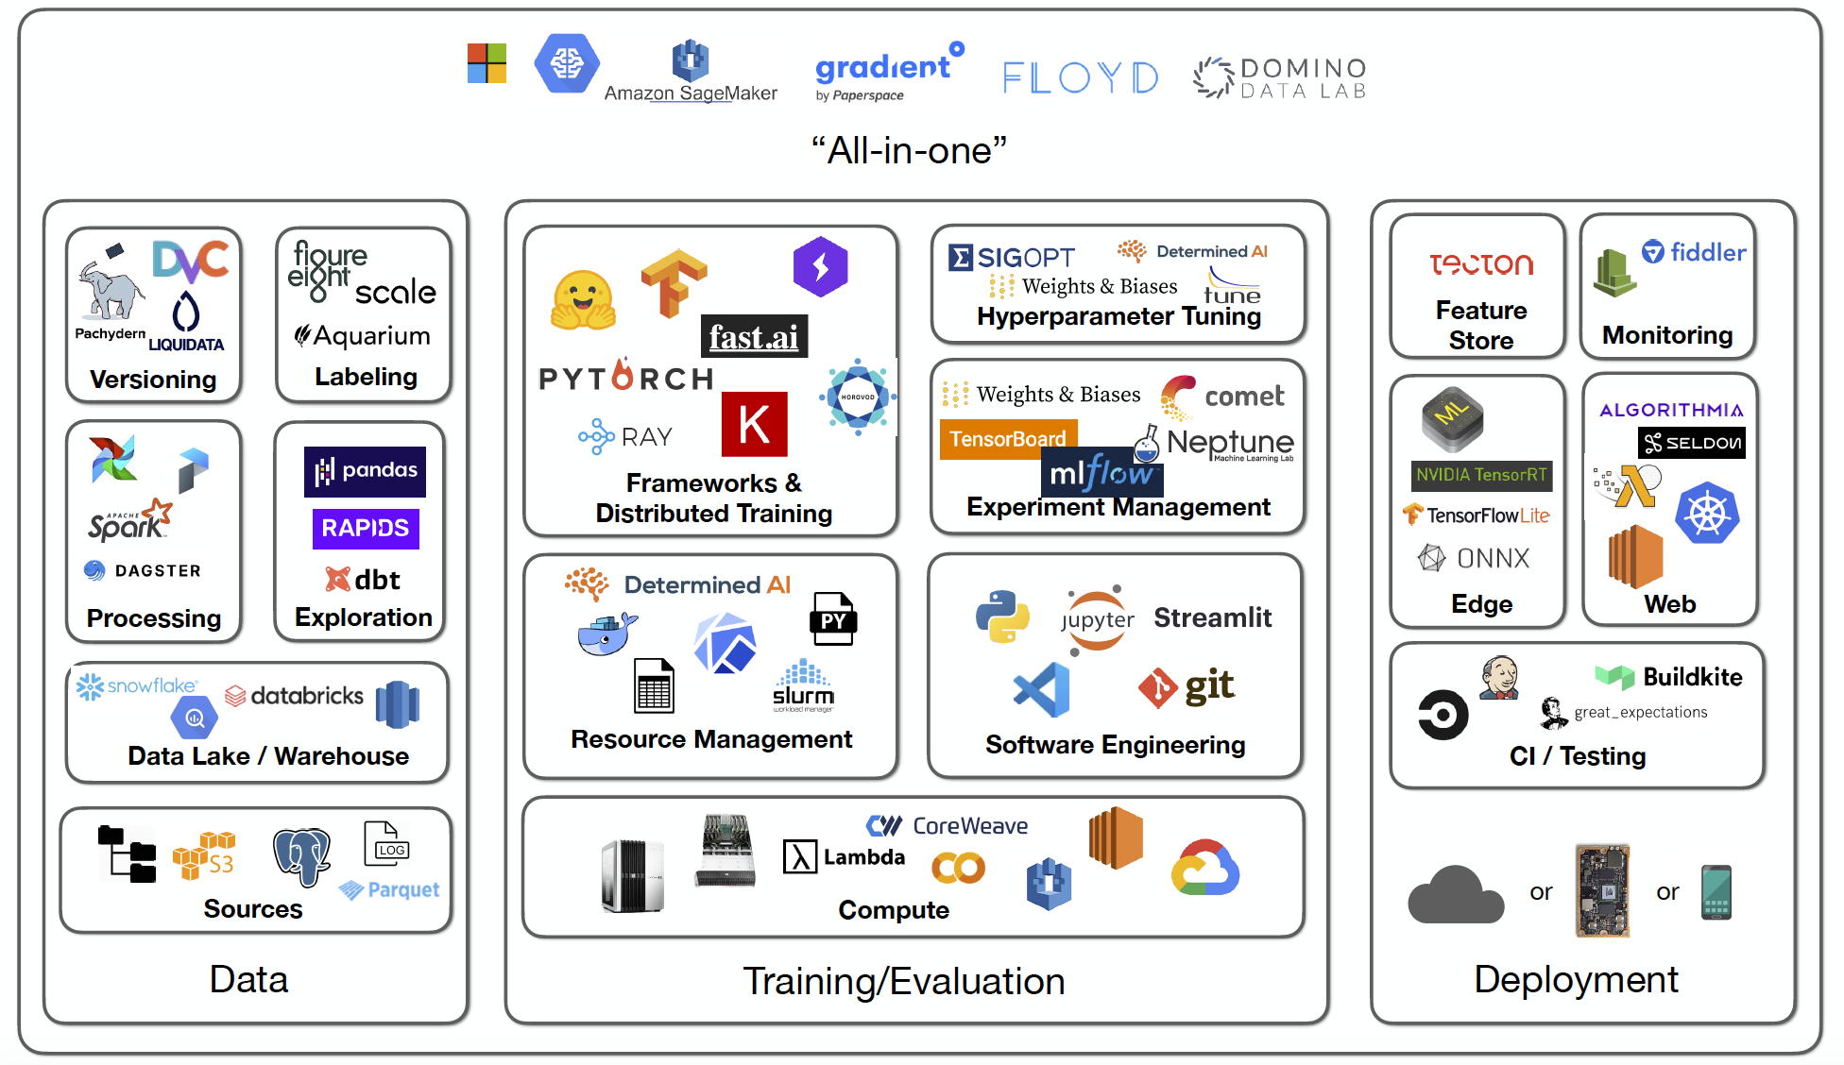
MLOps Tools
There are several tools that help us manage the different stages of MLOps, from tracking experiments to deploying and monitoring models
13

Slide 14

The Future of MLOps
More Automation
Focus on Fairness & Ethics
Cloud-Native MLOps
Self-Updating AI Systems
14

Slide 15
04
Deployment
step where a trained model is put into production so it can serve real users, while being monitored and maintained over time
15

Slide 16
Types of Deployment
Shadow Mode
Canary Deployment
Blue-Green Deployment
The new model runs in parallel with the live model, but its predictions are hidden from users, allowing safe comparison
The new model is released to a small subset of users first, and if it performs well, it’s gradually rolled out to everyone
Two environments (Blue = old, Green = new) run side by side, and traffic is switched from Blue to Green once the new model is ready
16

Slide 17
Shadow Mode Deployment
Definition: The new model runs in parallel with the current production model
How it works: Both models receive the same input, but only the production model’s output is shown to users. The shadow model’s output is stored and analyzed in the background
Purpose: Allows testing and evaluation without impacting users
Advantages:
Zero risk to users
Useful for comparing performance between old and new models
Helps discover hidden problems before going live
17

Slide 18
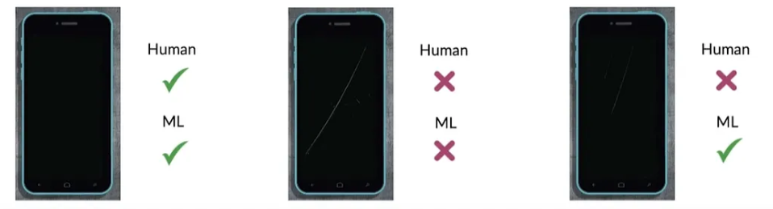
Shadow Mode Deployment
18

Slide 19
Canary Deployment
Definition: The new model is released to a small portion of users before full rollout
How it works:
A small group gets predictions from the new model
The rest continue with the old model
If results are stable, the rollout is gradually expanded
Advantages:
Early detection of issues with minimal risk
Real-world feedback from a small sample
Easy rollback if problems occur
19

Slide 20
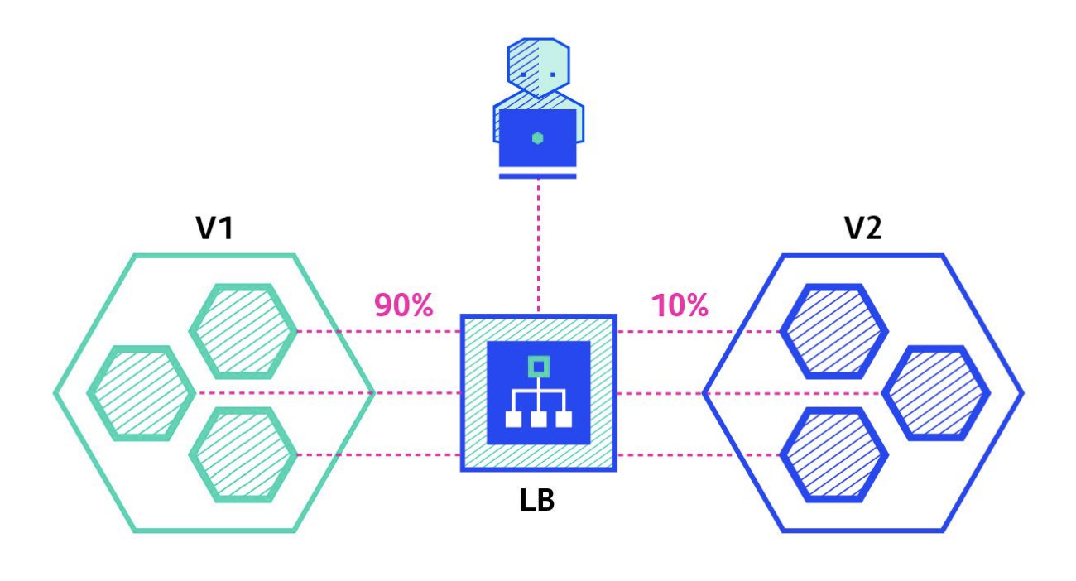
Canary Deployment
20

Slide 21
Blue-Green Deployment
Definition: Two identical environments exist — Blue (old) and Green (new)
How it works:
Blue is live while Green is being prepared with the new model
When Green is ready, traffic is switched from Blue → Green
If problems appear, switch back to Blue
Advantages:
Nearly zero downtime
Easy rollback
Safe transition between versions
21

Slide 22
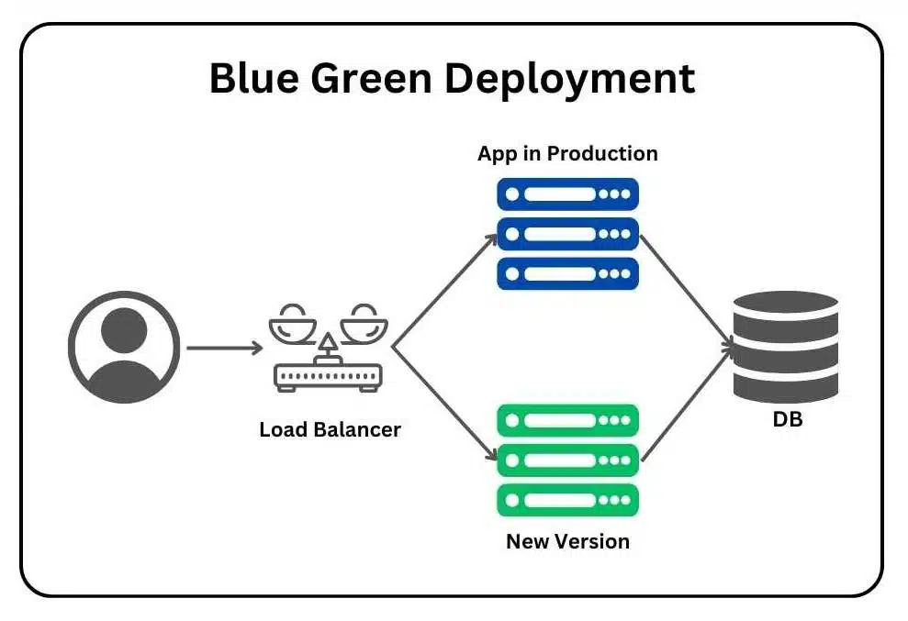
Blue-Green Deployment
22

Slide 23
Monitoring
23

Slide 24

Monitoring
Monitoring in MLOps means continuously tracking a model’s performance, data, and system behavior to ensure it stays accurate, reliable, and fair in production
24

Slide 25
How to Decide What to Monitor
25

Slide 26
1
2
Brainstorm the things that could go wrong
Brainstorm a few statics/metrics that will detect the problem
26

Slide 27
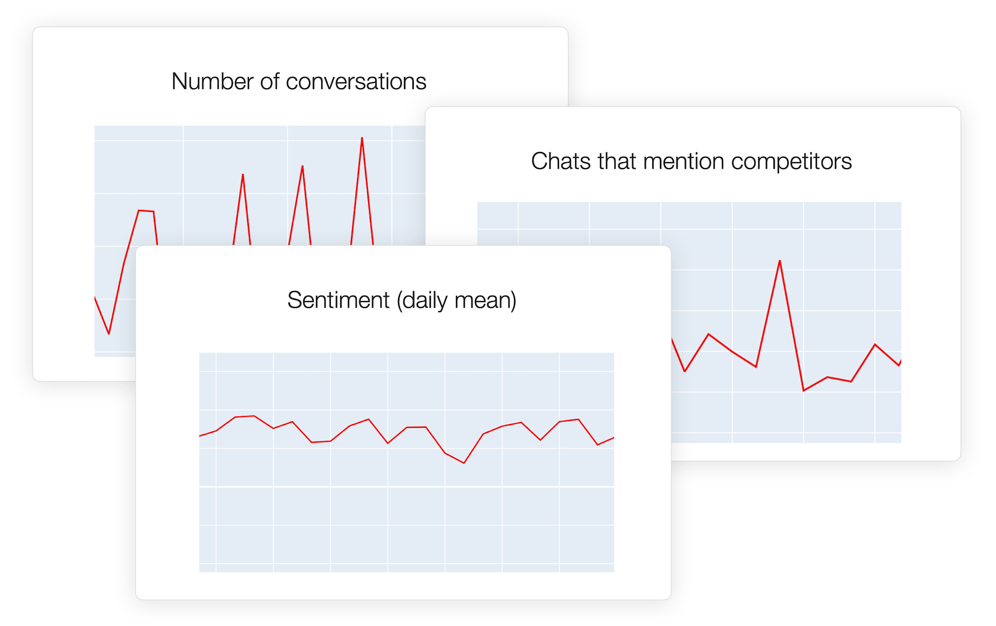
27

Slide 28
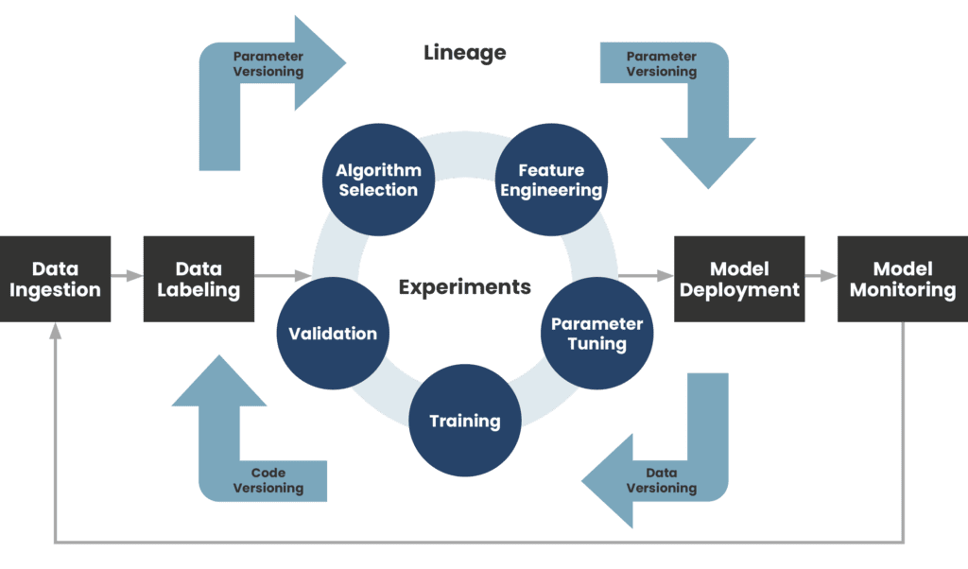
Both Model and Deployment are iterative
28

Slide 29
Examples of Metrics to Track
01
02
Performance
Data Quality
03
04
05
System
Fairness
Business
Accuracy, Precision, Recall, F1-score
Missing values, Outliers, Data drift
Latency, Throughput, availability
Bias detection, Stability over time
User satisfaction, feedback, Conversion rate
29

Slide 30

When Does a Model Need Updating?
Accuracy or performance drops compared to the baseline
Incoming data looks different from training data
the relationship between inputs (X) and outputs (Y) changes
new goals, rules, or regulations
30

Slide 31
Monitoring Pipeline
Data Collection
Detection
Action
Evaluation
Alerts
31

Slide 32
AI in Healthcare
32

Slide 33

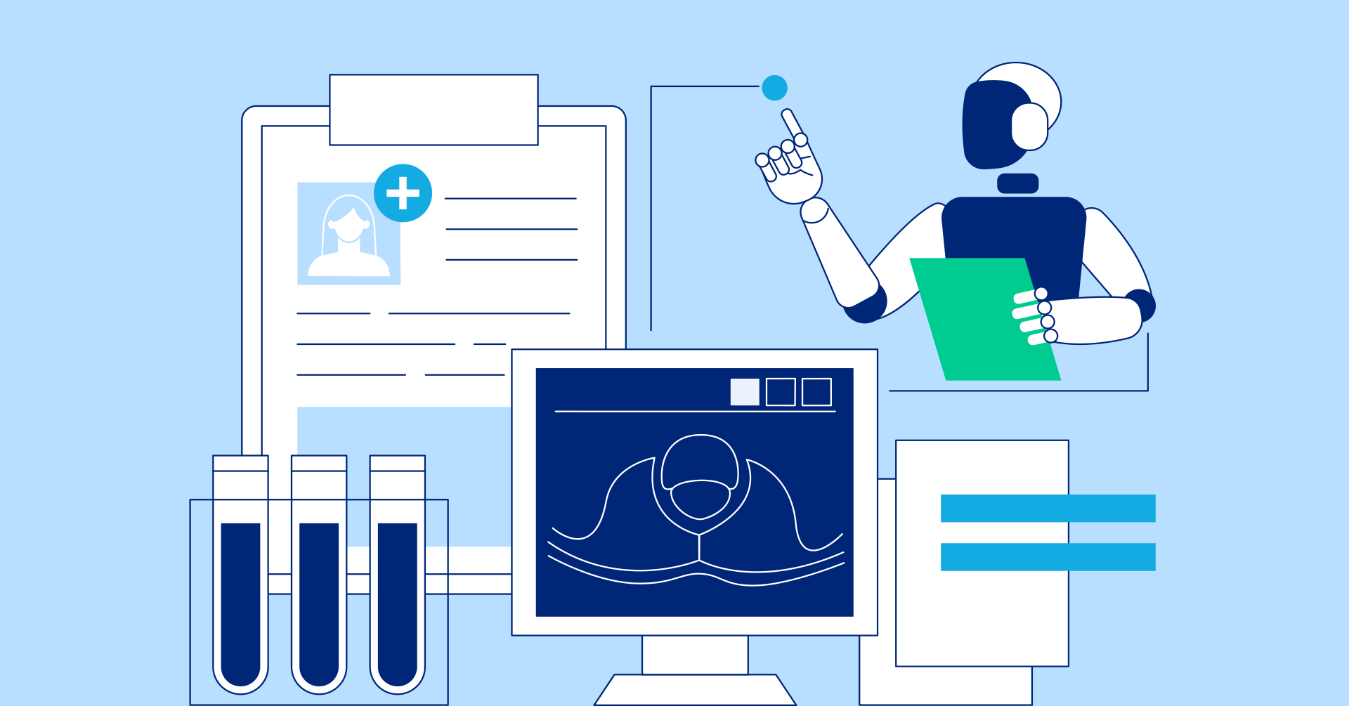
Introduction
Healthcare is data-rich but complex
AI supports diagnosis, prediction, and treatment
MLOps ensures AI is reliable, scalable, and safe
Example: AI can analyze X-ray images to detect pneumonia, and MLOps ensures the model is updated and monitored over time
33

Slide 34
Why AI in Healthcare?
Healthcare generates huge amounts of data (records, images, labs)
AI can find patterns that humans may miss
Supports faster and more accurate diagnoses
Helps doctors predict risks and personalize treatments
Improves hospital efficiency (scheduling, resources, costs)
34

Slide 35
Key AI Applications in Healthcare
Medical Imaging
Predictive Analytics
Personalized Medicine
Operational Efficiency
Detecting tumors, fractures, or pneumonia from X-rays, MRIs, CT scans
Estimating patient readmission risk, predicting disease progression
Recommending tailored drug treatments based on genetics and history
Optimizing staff scheduling, hospital bed allocation, and supply management
35

Slide 36

Example
AI can analyze a chest X-ray to detect early signs of pneumonia faster than a human radiologist.
36

Slide 37
Challenges in Healthcare AI
Data Privacy & Security
Patient records include sensitive details (genetics, history).
Example: A hospital AI system was hacked in 2021, exposing thousands of patient scans
Regulatory Compliance
Healthcare AI must follow strict laws (HIPAA, FDA approval).
Example: An AI diagnostic tool cannot be used in the U.S. until it passes FDA clearance
Bias & Fairness
AI may favor one group if data is imbalanced.
Example: A skin cancer detection model trained mostly on light skin tones failed on darker skin
Model Drift
Medical data changes over time, reducing model accuracy.
Example: A COVID-19 risk prediction model trained in 2020 performed poorly in 2022 because virus variants and treatments had changed
37

Slide 38
MLOps Workflow in Healthcare
Scoping
Data
Modeling
Deployment
S
D
Define the medical problem
Collect, clean, and label health data
M
D
Train & test models with error analysis
Integrate into hospital IT systems
38

Slide 39
Scoping in Healthcare
Define the Problem
Goal: Predict sepsis early to save patient lives
Why: Sepsis is life-threatening, and early detection is critical
Inputs (X)
Patient vital signs (heart rate, blood pressure, temperature)
Lab test results (white blood cell count, lactate levels)
Demographics (age, gender, medical history)
Output (Y)
Probability that a patient will develop sepsis in the next 30 days
39

Slide 40
Data in Healthcare
Collect Data
Patient electronic health records (EHRs)
ICU vital sign monitors (e.g., heart rate, blood pressure)
Label Data
Mark cases: Sepsis = Yes / No based on clinical diagnosis
Ground truth comes from doctors’ notes and lab confirmations
Organize Data
Structured: numbers like blood pressure, temperature
Unstructured: text notes, medical images, lab reports
Establish Baseline
Simple rule: If temperature > 38°C + heart rate > 100 → high risk
40

Slide 41
Modeling in Healthcare
Select a Model
Start simple → Logistic Regression
Move to complex → Random Forest, Deep Learning (LSTMs for time-series ICU data)
Train the Model
Use historical patient data with labeled outcomes (Sepsis = Yes/No)
Lab test results (white blood cell count, lactate levels)
Split data into training, validation, and test sets
Perform Error Analysis
Identify common mistakes → e.g., model misses elderly patients with atypical symptoms
Analyze false negatives carefully → these are critical in sepsis prediction
Improve by adding new features (e.g., trends in vital signs over time)
41

Slide 42
Deployment in Healthcare
Deploy in Production
Integrate model into the hospital’s ICU monitoring system
Predictions show up in the doctor’s dashboard or EMR (Electronic Medical Record)
Deployment Strategy
Shadow Mode → Run alongside doctors’ current system without showing predictions
Canary Deployment → Test in one ICU ward before rolling out hospital-wide
Monitoring in Deployment
Track accuracy on live patient data
Watch for false negatives (missed sepsis cases)
Monitor system latency → predictions must be real-time
Maintain the System
Update the model with new hospital data regularly
42

Slide 43
MLOps makes AI in healthcare safe, reliable, and trusted
Reliability → Continuous monitoring keeps models accurate
Collaboration → Doctors + engineers work better together
Compliance → Meets strict medical regulations
Speed → Faster updates and safer deployments
Trust → Transparent AI builds confidence for doctors & patients
43

Slide 44
Thanks!
Do you have any questions?
44

